Slide 1
Essentials Of Fire Fighting
Seventh Edition
Chapter 19
Incident Scene Operations

Slide 2
Learning Objective 1
Explain the process of initiating incident operations.

Slide 3
Initiating Operations
Establish command and communicate who is in command
Communicate information and actions to en route resources
360-degree check
First-arriving firefighter acts as IC
Assign tasks
Determine offensive or defensive mode

Slide 4
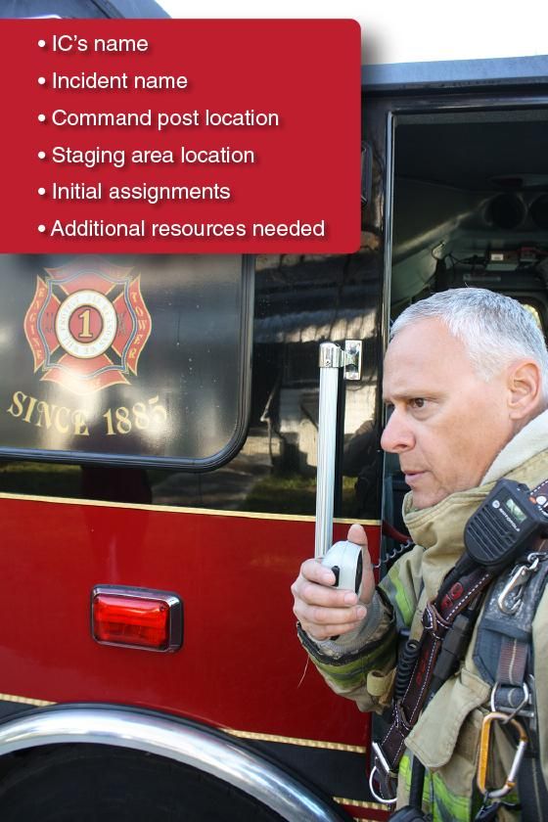
Establishing Command
Specify acting IC
State name of the incident
State location of Command Post
State location of staging areas
Make initial assignments to available resources
Call additional resources

Slide 5
Initial Assignments
Place company into action with remaining members
Assign crew members to work under supervision of another firefighter
Every effort should be made to maintain company/crew integrity

Slide 6
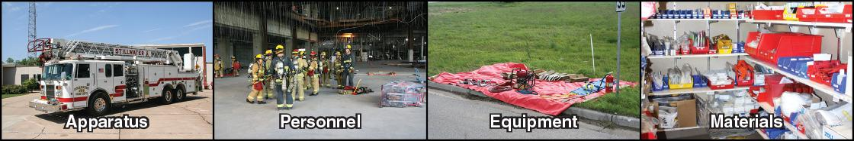
NIMS-ICS
Management of resources is essential to all incident scene management
(Cont.)

Slide 7
NIMS-ICS
Establishes organizational structure for all emergency incidents
Must be used on all incidents

Slide 8
NIMS-ICS Characteristics
Common terminology for functional structure
Modular organization
Common communications
Unified command structure
IAP: verbal and/or written
(Cont.)

Slide 9
NIMS-ICS Characteristics
Manageable span of control
Predesignated incident facilities
Comprehensive resource management
Personnel accountability

Slide 10
REVIEW QUESTIONS
What must the first arriving firefighter do when establishing Command?
What is the purpose of NIMS-ICS?

Slide 11
Establishing Communications
Good communication enables arriving commander to make progress when he or she arrives
Initial IC
  Establishes communications with available resources and arriving units according to local protocols
  Relays this information to higher-ranking officer when he or she arrives
(Cont.)

Slide 12
Establishing Communications
Incoming IC should be able to handle these communications without incident if communications have been established correctly
  Periodic progress reports
  Transfer of Command
  Change in Command Post location
  Progress (or lack of) toward incident stabilization
  Direction of fire spread
  Exposures by direction, height, occupancy, and distance
  Unanticipated actions or events
  Anticipated actions
  Need for additional resources
(Cont.)

Slide 13
Establishing Communications
Reports
  Telecommunications center may be assigned to provide periodic transmissions at designated intervals
  Individual units provide tactical progress reports to IC
  Reports must be accurate and concise
  Form is based on SOPs

Slide 14
Conducting Size-Up
Incident management should reflect overall incident priorities
Life safety
Incident stabilization
Property conservation
(Cont.)

Slide 15
Conducting Size-Up
Ongoing process of evaluating an emergency
  What has happened (nature and scope of the incident)?
  What is happening?
  What is likely to happen?
  What resources are available with the initial response?
  What actions are necessary to affect control?
  What additional resources will be needed to mitigate the incident?
(Cont.)

Slide 16
Conducting Size-Up
IC must integrate information gathered during size-up with the strategic goals
  Information gathered while responding
  Information from initial 360-degree size-up
  Life safety information
  Fire behavior indicators
  Evaluations of fire growth and development

Slide 17
Size-Up While Responding
Review building’s preplan (if available)
Observe weather conditions
Observe amount, color, and movement of smoke
Consider every structure to be occupied until determined otherwise
Be aware of resources responding or that may be needed

Slide 18
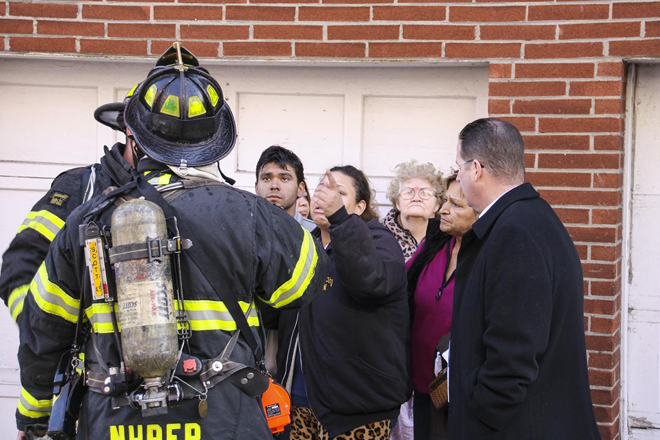
Size-Up On Arrival
Size-up should intensify on arrival
Scene may be chaotic
Bystanders may place themselves in danger
Courtesy of Ron Jeffers, Union City, NJ
(Cont.)

Slide 19
Size-Up On Arrival
Rapid assessment
  Are there occupants in need of immediate rescue?
  Does the fire threaten other exposures?
  What does the visible fire and smoke indicate?
  Are only the contents involved or is the structure burning?
  How much of the structure is on fire?
  Is the fire ventilated and at what location?
  Are there sufficient resources on scene or en route?
(Cont.)

Slide 20
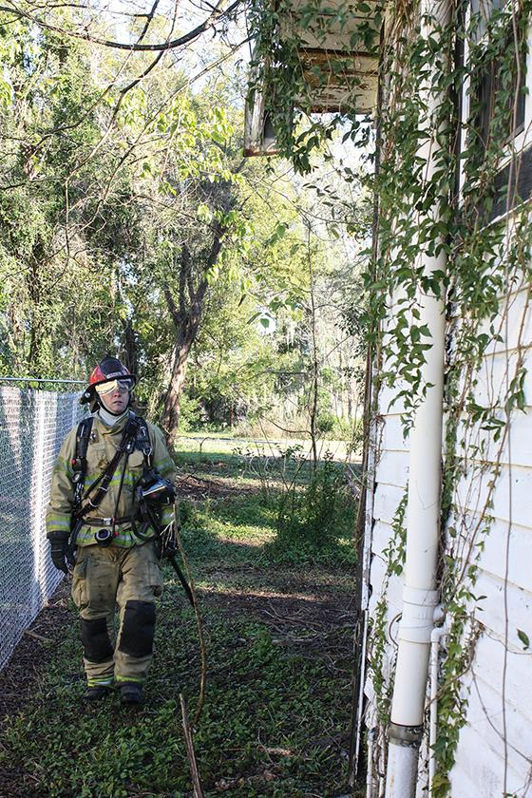
Size-Up On Arrival
360-degree survey information
  Victim survivability based on conditions
  Indicators of fire location
  Lowest floor of fire involvement
  Smoke conditions
  Forcible entry requirements
  Location of building utilities
  Special hazards
  Building construction
  Location of FDCs
(Cont.)

Slide 21
Size-Up On Arrival
Identify potential changes to conditions and means of escape or safe haven for crews
  Observe fire behavior indicators to anticipate how conditions may change
  Identify flow path
  Identify building’s construction type and collapse potential
  Locate alternate exits
  Identify possible safe havens

Slide 22
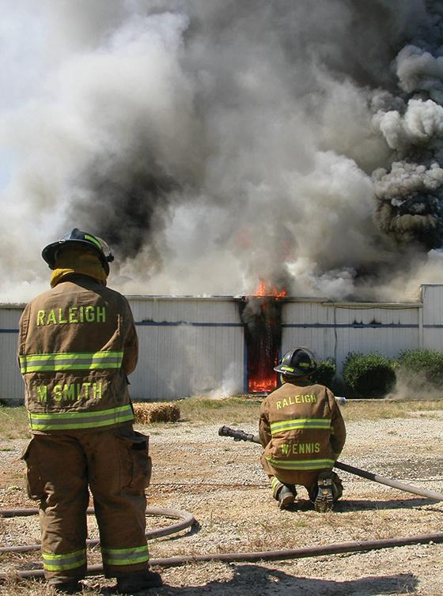
Fire Behavior Indicators
Smoke
  Volume of smoke discharge
  Location of discharge
  Color, density, velocity
(Cont.)

Slide 23
NOTE
Report any rapid or significant change in smoke conditions.

Slide 24
Fire Behavior Indicators
Air and smoke flow
  Indicators — Velocity, turbulence, direction, and movement of the neutral plane
  Causes — Pressure differentials and differences in density between hot smoke and cooler air
  Flow path — Connection between the intake and exhaust
(Cont.)

Slide 25
Fire Behavior Indicators
Heat
  Visual indicators — Blistering paint, bubbling tar, crazed glass
  Thermal imager or infrared sensor may provide data on internal temperature differences
Flame
  Visible flames may indicate size and location of fire
  Size and extent of fire may indicate effect of fire streams on flaming combustion
  Flames visible from outside can allow firefighters to assess flame indicators, ventilation, and air flow

Slide 26
CAUTION
Do not rely solely on the presence or location of flames to assess an incident.

Slide 27
Evaluations Of Fire Growth And Development
Factors that influence command decisions and orders to be given
Forecasting fire growth and development
Identifying scene hazards
Identifying ventilation flow path

Slide 28
REVIEW QUESTION
What observations should be made during initial and ongoing size-up?

Slide 29
Transmitting The Arrival Report
Arrival report should
  Provide routing instructions and assignments to arriving units
  Provide first impression of hazardous conditions
  Report initial actions taken
  Identify types and locations of barriers that could impede access
  Indicate planned operational strategy
(Cont.)

Slide 30
Transmitting The Arrival Report
Communicate IAP to personnel
Look at the scene from all sides
Evaluate resources

Slide 31
Initial Risk Assessment
First-arriving firefighters make decisions based on acceptable risk
Risk assessment should be ongoing
Risk assessment may influence incident goals and priorities

Slide 32
Condition Indicators
Initial decisions must be made based on accurate, complete information
Visual clues provide condition indicators
Company officers should seek confirming indicators/factors when making critical decisions

Slide 33
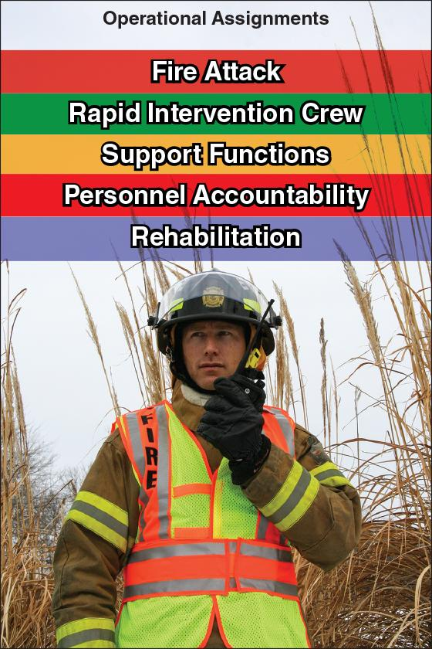
Operational Assignments

Slide 34
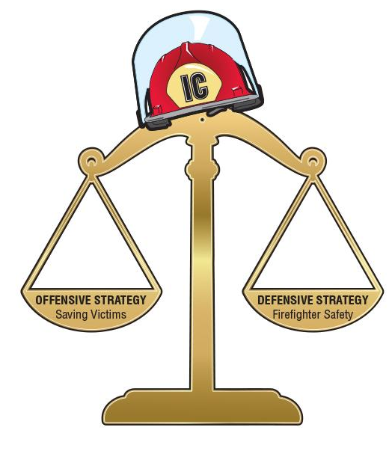
Operational Strategies
IC conducts risk/benefit analysis
Determines operational strategy
(Cont.)

Slide 35
Operational Strategies
Risk-benefit analysis
Offensive
Defensive
  Benefits of fire attack outweigh risk to responders
  Offensive strategy would unnecessarily endanger firefighters
  Occupants are not savable
  Conditions indicate that survival of trapped victims is unlikely
  Property is not salvageable
  No threat to occupant life
(Cont.)

Slide 36
Operational Strategies
Resources
Offensive
Defensive
  Resources will be enough to implement and accomplish an effective plan to attack fire or conduct rescue
  Amount of fire exceeds ability of available resources to extinguish it
  Too few personnel or lack of trained personnel
  Inability to provide adequate water flow
  Lack of appropriate apparatus or equipment
(Cont.)

Slide 37
Operational Strategies
Structural integrity
Offensive
Defensive
  360 size-up and other information gathered does not indicate structural collapse
  Contents are on fire, but fire has not spread to structural members
  Building is in danger of collapse
  Structural members are burning and part of the fuel load
(Cont.)

Slide 38
Operational Strategies
Wind conditions
Offensive
Defensive
  Attack can come from upwind side
  Wind conditions will not affect ventilation tactics
  Attack has to be into the wind
  Wind conditions increase potential development of high temperature flow paths in the structure
(Cont.)

Slide 39
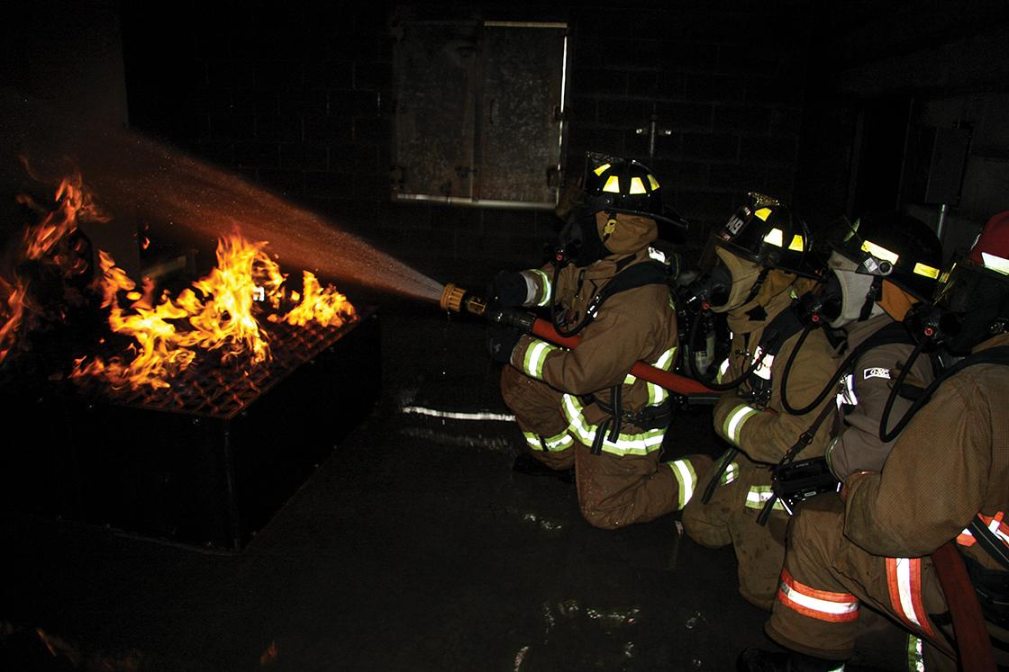
Operational Strategies — Offensive
(Cont.)

Slide 40
Operational Strategies — Offensive
Assess risks and take action to reduce risk
Direct fire attack (exterior, interior, or transitional attacks)
Rescue and extinguishment may occur simultaneously or rescue may be the primary activity

Slide 41
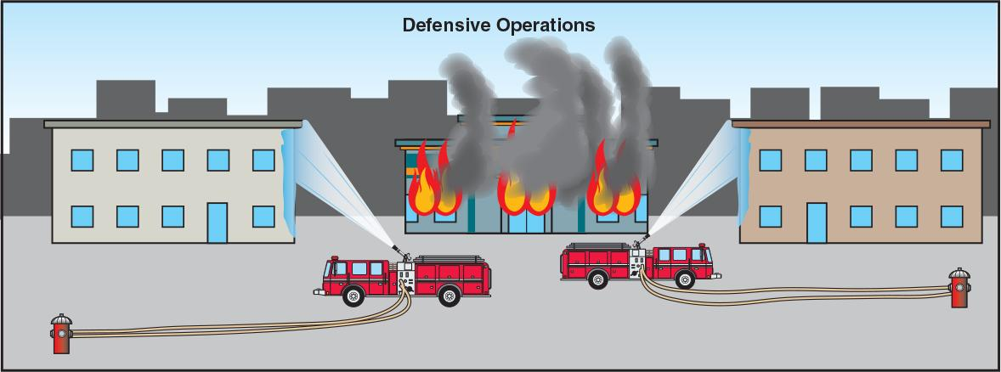
Operational Strategies — Defensive
No one is entering the IDLH environment
May mean sacrificing a burning building to save adjacent buildings
(Cont.)

Slide 42
Operational Strategies — Defensive
Protect exposures
Control fire spread
Confine fire to involved structure without entering the building
Probability of saving lives is unlikely and risk to firefighters outweighs possible gain
May indicate a need for additional resources

Slide 43
Requests For Additional Resources
Too few resources to meet incident objectives
Request additional resources
Adhere to two-in, two-out regulation
Know local procedure
Know resources that alarm assignments include

Slide 44
REVIEW QUESTIONS
What items should be included in the arrival report?
What are five operational assignments that the Incident Commander can make for personnel at the scene?

Slide 45
REVIEW QUESTION
What is the difference between an offensive strategy and a defensive strategy?

Slide 46
Learning Objective 2
Explain the process of transferring Command.

Slide 47
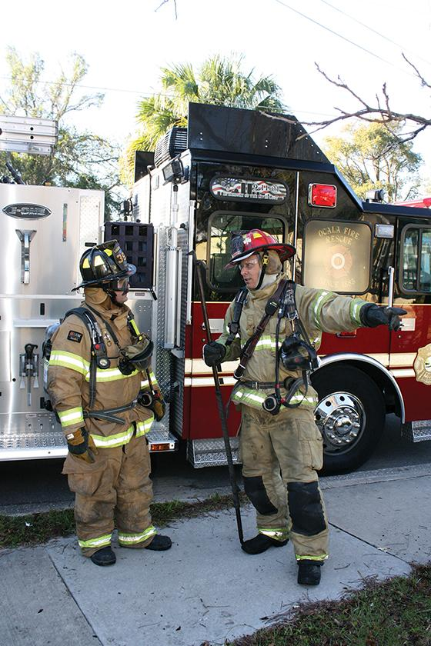
Transferring Command
Officer assuming Command communicates by radio or face-to-face with the officer/firefighter being relieved
Command should never be transferred to anyone not at the scene
(Cont.)

Slide 48
Transferring Command
Officer/firefighter being relieved should brief the relieving officer
Name of the incident
Incident status
Safety considerations
Goals and objectives listed in the IAP
Progress toward completion of tactical objectives
Deployment of assigned resources
Assessment of need for additional resources
(Cont.)

Slide 49
CAUTION
Never transfer command to anyone who is not on the scene.

Slide 50
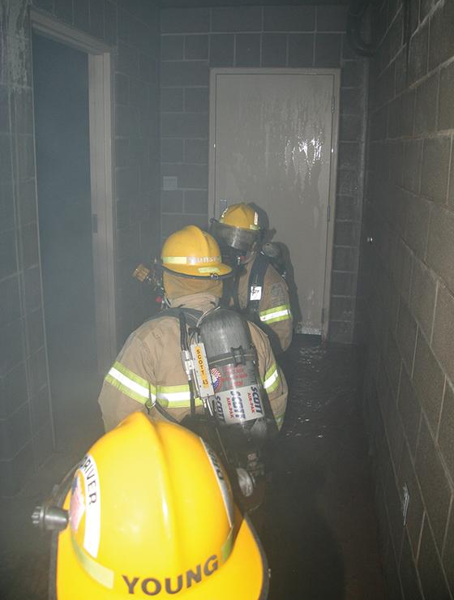
Transferring Command
Command is transferred
New IC assigns duties to initial IC
  Lead a unit coordinating interior attack
  Lead crews performing other tasks
  Work as a member of a crew under a different leader

Slide 51
REVIEW QUESTION
When transferring Command, what information must the first Incident Commander provide to the person assuming Command?

Slide 52
Learning Objective 3
Describe the duties of a unit or team leader during fireground operations.

Slide 53
Coordinating Unit Operations
Selecting tactics
Selecting tools
Crew leader responsibilities
Monitoring safety
Coordinating resources
Remaining prepared to change tactics

Slide 54
Selecting Hoselines
Selection factors
  Fire conditions
  Fire load and material involved
  Flow rate needed for extinguishment
  Stream reach needed
  Number of firefighters available to advance hoselines
  Need for speed and mobility
  Tactical requirements
  Ease of hoseline deployment
  Potential fire spread
  Size of building
  Size of fire area
  Location of fire
(Cont.)

Slide 55
Selecting Hoselines
Selecting the correct hoseline is critical for efficiency and safety
Most important variable is flow rate
Initial attack line shall provide minimum flow of 100 gpm (400 L/min)
(Cont.)

Slide 56
CAUTION
The initial attack line shall provide a minimum flow of 100 gpm (400 L/min) from the nozzle.

Slide 57
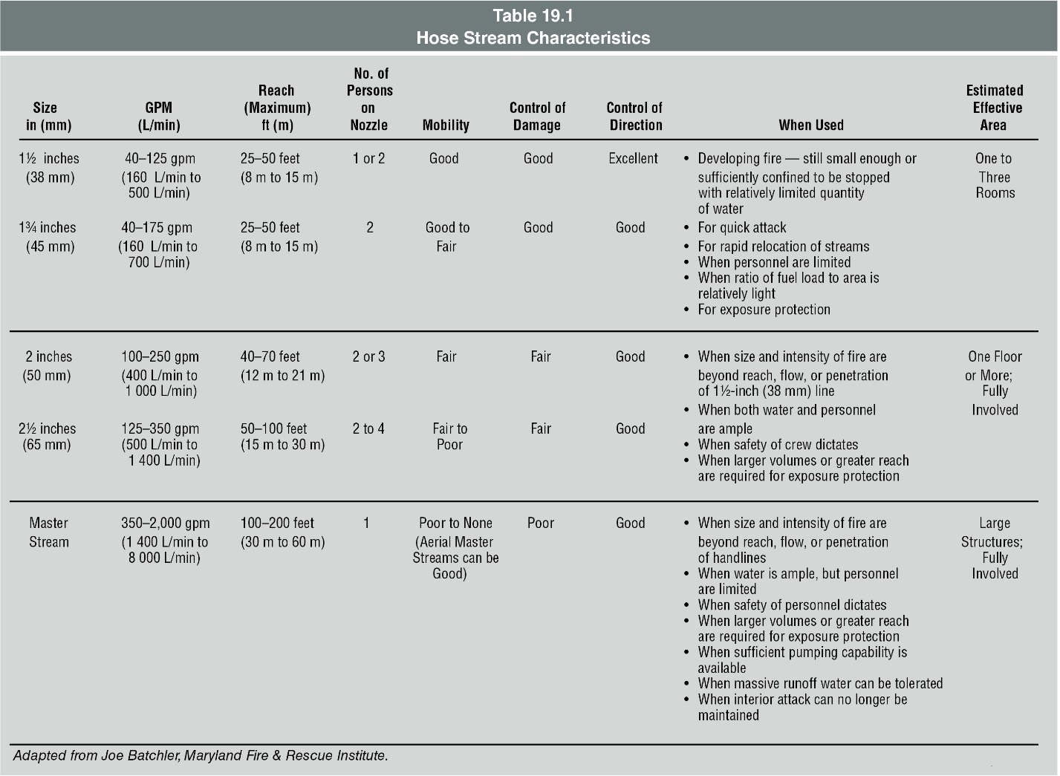
Selecting Hoselines
(Cont.)

Slide 58
Selecting Hoselines
Backup hoseline
Protects attack hoseline team from extreme fire behavior
Protects means of egress for attack hoseline team
Provides additional suppression capability in case fire increases in volume
Should be at least the same size and provide the same flow as the attack hoseline
Fog nozzle is preferred

Slide 59
REVIEW QUESTION
What factors help determine the size of the hoseline to be used for fire attack?

Slide 60
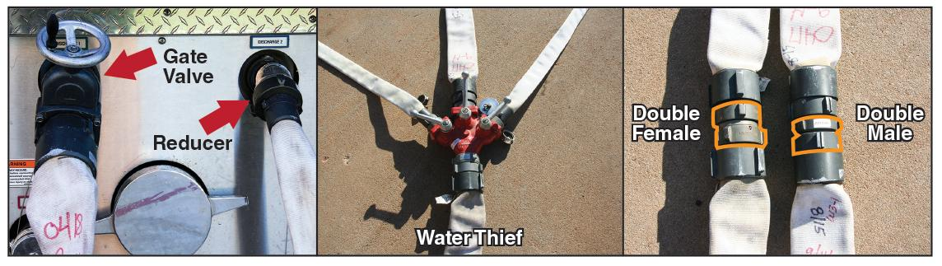
Selecting Hose Appliances
(Cont.)

Slide 61
Selecting Hose Appliances
Wye
  Useful when one attack line is laid, but two are needed
Siamese
  Useful when hydrant doesn’t have LDH connection
  Allows combination of two 2½-inch connections from the hydrant into one LDH
(Cont.)

Slide 62
Selecting Hose Appliances
Gate valve
  Useful when more than one attachment needs to be made to the same hydrant
  Allows second hose to connect to the hydrant without shutting the hydrant
Water thief
  Useful when smaller line is needed but larger line is in service
  Adapts larger line to the smaller line
(Cont.)

Slide 63
Selecting Hose Appliances
LDH appliance
  Useful when multiple attack lines need water directly from the hydrant
  Sometimes known as a portable hydrant
Fittings
  Useful for connecting hoses that may have been laid backward, extending different sized hoselines, connecting hose threads of different sizes, and connecting hose to a different size discharge

Slide 64
REVIEW QUESTION
List five fittings or appliances that may be used on the fireground.

Slide 65
Selecting Nozzles
Factors that dictate nozzle and stream selection
Fire conditions
Available water supply
Number of firefighters available to operate the hoseline
Nozzle capabilities
(Cont.)

Slide 66
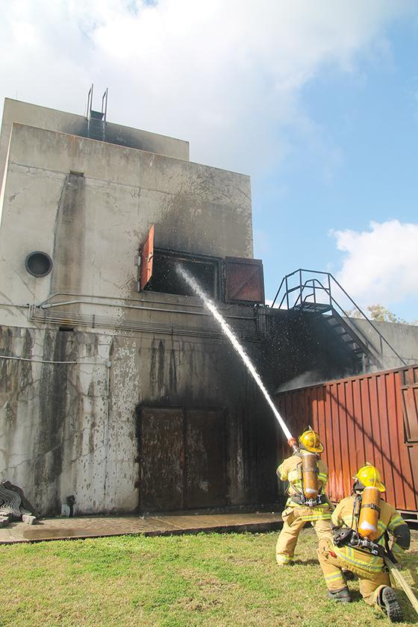
Selecting Nozzles
Interior attack
  Wide fog pattern can be used to protect firefighters from heat, but can change pressure and flow path
  Fog pattern can be narrowed to create straight or broken streams
Exterior attack
  Solid stream from smooth bore nozzle or straight stream from an adjustable nozzle would be the top choices

Slide 67
REVIEW QUESTION
What factors must be considered when selecting a nozzle?

Slide 68
Making Entry — Hoseline Placement Factors
Wind direction and velocity
Building conditions
Initial fire location
Location of occupants
Exposures

Slide 69
Making Entry — Size-up
Conduct a quick size-up
Every member should
Maintain situational awareness
Begins before reaching the entry point
Size-up
May include visual observations and use of a TI

Slide 70
Making Entry — Pre-entry Safety Considerations
Reading fire behavior indicators
Understanding the crew’s tactical assignment
Identifying potential emergency escape routes
Evaluating forcible entry requirements
Identifying hazards
Verifying that radios receive and transmit on the correct channel
Ensuring that SCBA is on and that the cylinder is full and operating properly
Ensuring that all PASS devices are on and operating properly
Ensuring other team members are prepared to enter (buddy check)
Ensuring that personnel check in with the accountability officer

Slide 71
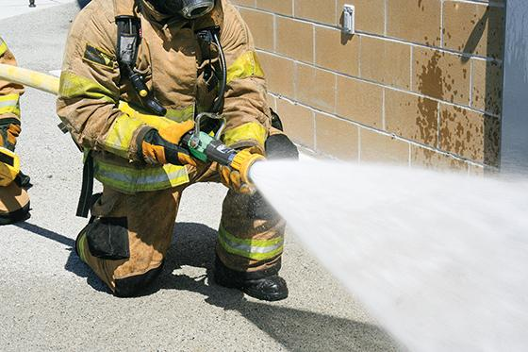
Making Entry — Pre-entry Actions
Interior and attack crews must carry tools
Nozzle firefighter should check the nozzle flow and pattern
Wait in a safe area near the building and extinguish visible fires
Check the door for heat

Slide 72
CAUTION
After forcing entry, control the door (leave it closed) until attack or search teams are ready for entry.

Slide 73
Making Entry — Door Control
Door should be kept closed until hoseline is charged and crew is ready to enter
Attack crew should stay low and out of the doorway while it is forced open
Door should only be opened the minimum distance needed
If fire is ventilation controlled and the door is opened, heat release rate can significantly increase
(Cont.)

Slide 74
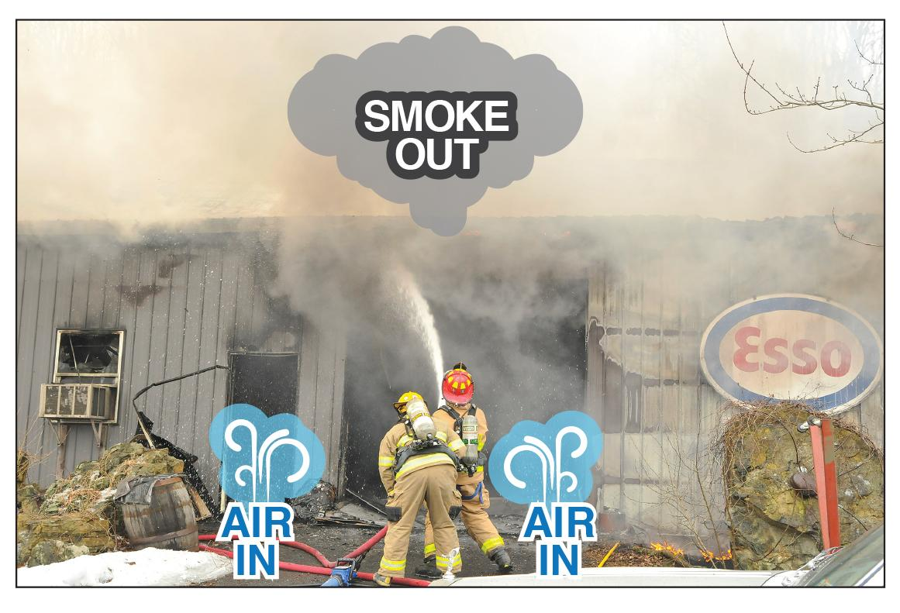
Making Entry — Door Control
Cooling hot gases
  Can reduce risk of ignition potentially leading to flashover
  Can provide a safer operating environment
Photo courtesy of Bob Esposito, Pennsburg, PA
(Cont.)

Slide 75
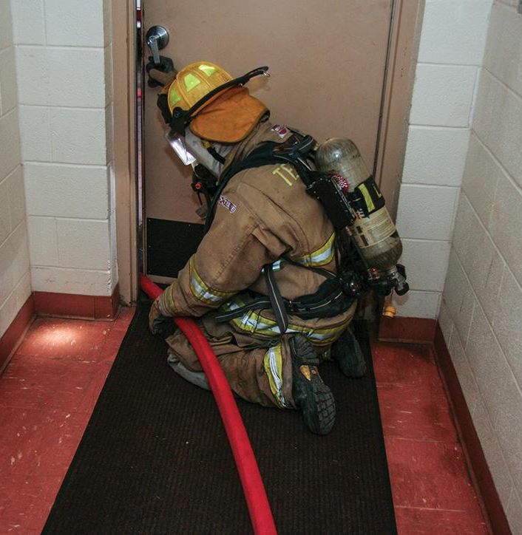
Making Entry — Door Control
Observe smoke movement and air flow when door is opened
Apply water to hot gas layer before entering the structure
Maintain control of the door — Make sure it is opened only when ordered to be

Slide 76
Making Entry — Attacking From The Unburned Side
Conventional guideline that was disproven by laboratory tests
Factors have changed the fire service’s understanding of structure fire behavior
Wind creates air flow patterns that increase fire expansion
Attack with the wind at your back
Determine entry point based on size-up

Slide 77
REVIEW QUESTION
After sizing up the situation, what must firefighters do before making entry to the building?

Slide 78
Emergency Radio Traffic
Urgent broadcasts intended to warn personnel of a hazard
Broadcast may originate from the Command Post or any unit or individual at the scene
Begins with a clear statement to alert listeners to pay attention and stay off the air
Dispatch or IC acknowledges the statement, then the unit originating the transmission states the hazard and action required

Slide 79
Evacuation Signals
Used when interior operations must cease and all firefighters must immediately withdraw from the building
Be familiar with SOPs for declaring an evacuation signal
May be a radio message or audible warning devices may be used

Slide 80
MAYDAY
MAYDAY — Distress call from firefighters
When MAYDAY is broadcast
  All nonessential operations cease
  RIC is dispatched to assist distressed firefighters
  Local SOPs dictate radio traffic

Slide 81
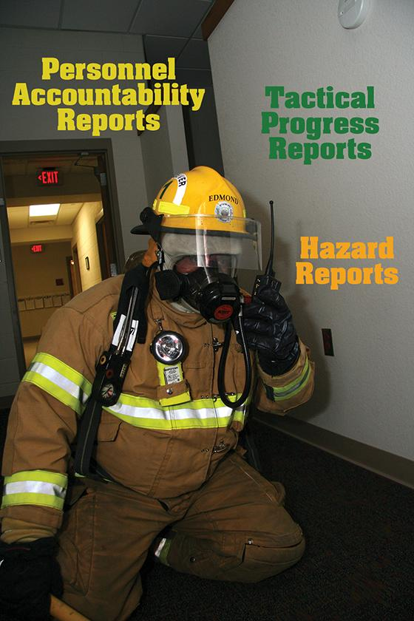
Status Reports
Personnel accountability reports (PARs)
Tactical progress reports
Hazard reports

Slide 82
Strategic Transitions
May occur at any time, usually because of rapid changes in conditions
Transition from defensive to offensive is more common and less dangerous
Transition from offensive to defensive occurs when conditions deteriorate rapidly and unexpectedly
IC calls for transitions when needed
(Cont.)

Slide 83
Strategic Transitions
Defensive to offensive
  First-arriving unit may need to begin with defensive strategy until more resources arrive or fire has been reduced
  May be necessary when there are not enough firefighters to meet two-in, two-out regulation
  Firefighters can protect exposures or limit fire development while waiting for additional personnel
  Offensive interior strategy can be employed once additional personnel, apparatus, and adequate fire flow are available
(Cont.)

Slide 84
Strategic Transitions
Offensive to defensive
  When situation rapidly changes, IC must decide to transition to a defensive strategy
  How transition occurs depends on speed at which situation changes
  IC communicates change to all personnel and requests a PAR
  All personnel must be aware of the transition
(Cont.)

Slide 85
Strategic Transitions
Offensive to defensive
  Some units may need to remain in place to protect egress/withdrawal of other units
  Hoselines should not be abandoned unless absolutely necessary
  RIC personnel must be ready to assist units
  Companies should continue to perform assignments during the transition
(Cont.)

Slide 86
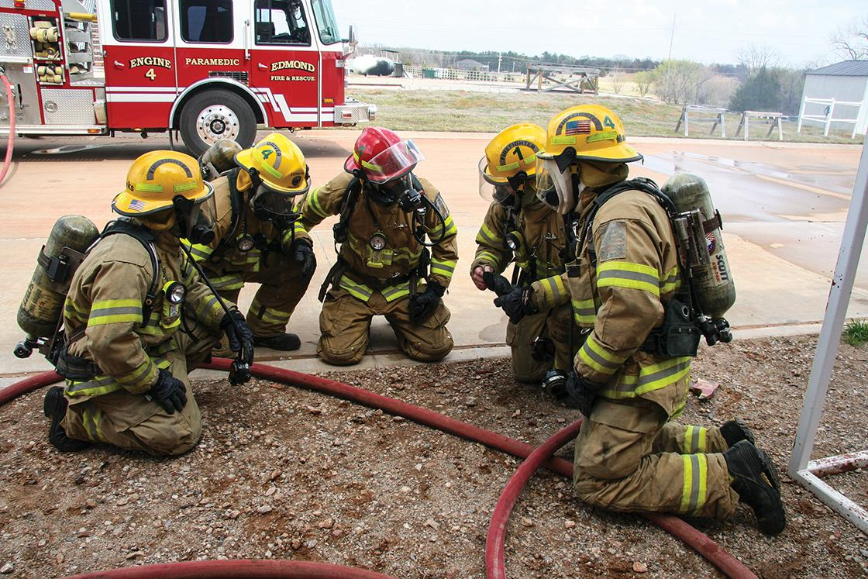
Strategic Transitions
Supervisors/company officers must know location of their personnel and conduct personnel accountability checks when withdrawal is complete
(Cont.)

Slide 87
Strategic Transitions
Offensive to defensive
  Use situational awareness to recognize changes in fire behavior and structural stability
  Know department’s evacuation signal
  Monitor radio for orders
  Remain calm and follow orders
  Stay with your team
  Use hoseline to guide you to an exit
  Use hoseline and have nozzle set on the appropriate pattern to protect you during withdrawal
  Evacuate as quickly and safely as possible
  Respond to requests for PAR
  Know SOPs on offensive and defensive strategies
(Cont.)

Slide 88
REVIEW QUESTIONS
What must be done if an emergency message is transmitted on the radio?
What are the three types of status reports used by most departments?

Slide 89
DISCUSSION QUESTION
Provide an example of a fireground situation that would require the transition from an offensive strategy to a defensive strategy.

Slide 90
Coordinating Resources
Forcible entry
Search and rescue
Fire attack must be coordinated with
Ventilation
Utility control
Loss control
Cause determination
Victim recovery

Slide 91
Search And Rescue Coordination
Attack crew leader should be aware of search and rescue activities
  Choose tactics that support searching firefighters
  Remain in communication with IC and search teams to report changes to interior conditions
Discovering victims that were not known to be in the structure
  Communicate with IC or rescue crew
  Continue attack or communicate and attempt to rescue the victim
Search and rescue teams take hoselines for protection, not fire attack

Slide 92
Ventilation Coordination
Attack crew must remain in good communication with ventilation crews
Contact IC and coordinate water application with ventilation if interior conditions worsen
During or after water application, direct the crew to ventilate in an area that will allow you to safely proceed with fire attack
Communicate whether or not tactics have been successful
Coordination and communication may allow ventilation crews to reach safety if interior conditions indicate possible collapse
Ventilation crews should always know the location of interior crews

Slide 93
REVIEW QUESTION
Why is it critical for attack crews to communicate and coordinate effectively with search and rescue teams and ventilation crews?

Slide 94
DISCUSSION QUESTION
You are the leader of the attack crew at a structure fire. You notice that the neutral plane is beginning to lower, and you hear something that sounds like roof beams cracking. What actions should you take?

Slide 95
Strategies For Energized Utility Fires (Class C)
Priorities for Class C fires
  Create a perimeter a safe distance around the hazard
  Contact the proper authority to turn off the electricity
Firefighting should be defensive until those priorities are accomplished
Once electricity is off, the fire may self-extinguish or become a Class A or B fire

Slide 96
WARNING
Before initiating fire suppression activities, stop the flow of electricity to the device involved.

Slide 97
Electrical Hazards
Be familiar with electrical transmission systems within the response area
Electrical utility company will provide training to the fire department
Electrocution is associated with high-voltage equipment, but conventional residential current can also deliver a fatal shock
Controlling electrical power reduces danger of igniting adjacent combustibles or energizing electrical equipment
(Cont.)

Slide 98
Electrical Hazards
Consequences of electrical shock
  Cardiac arrest
  Ventricular fibrillation
  Respiratory arrest
  Involuntary muscle contractions
  Paralysis
  Surface or internal burns
  Damage to joints
  Ultraviolet arc burns to the eyes

Slide 99
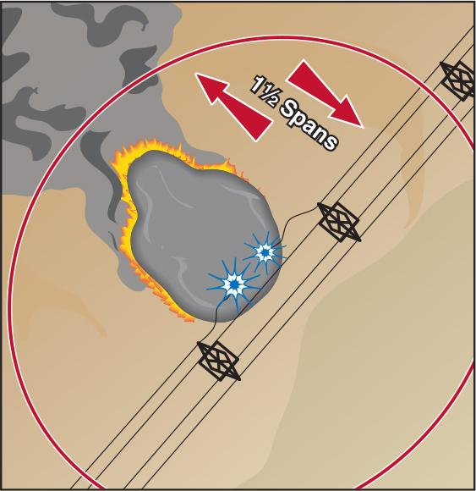
Guidelines For Electrical Emergencies
Assume all electrical wires, equipment, and devices are energized
Establish an exclusion zone equal to 1½ times the distance between power poles in all directions from downed power lines
(Cont.)

Slide 100
Guidelines For Electrical Emergencies
Be aware that a short circuit may have weakened wires and they could fall at any time
Wear full PPE
Guard against electrical shocks, burns, and eye injuries from electrical arcs
Wait for utility company workers to cut power lines
Stay at least 10 feet (3 m) from power lines when raising or lowering ladders or aerial devices
Do not touch any vehicle or apparatus in contact with electrical wires
(Cont.)

Slide 101
Guidelines For Electrical Emergencies
Be aware that live wires outside your field of view may be in contact with wire mesh or steel rail fences, posing an electrocution hazard
When wires are down, heed any tingling sensation in the feet and back away
Assume all wires are energized until a technician confirms otherwise
Maintain a large safety zone around electrical wires to avoid ground gradient hazards
Remain inside vehicle or apparatus that is in contact with power lines

Slide 102
Ground Gradient
Electrical wires on the ground can be dangerous, even without being touched
  Can energize metal objects they come in contact with
  When an energized wire comes in contact with the ground, current flows outward from the point of contact
  Voltage drops progressively as the current flows away from the point of contact
(Cont.)

Slide 103
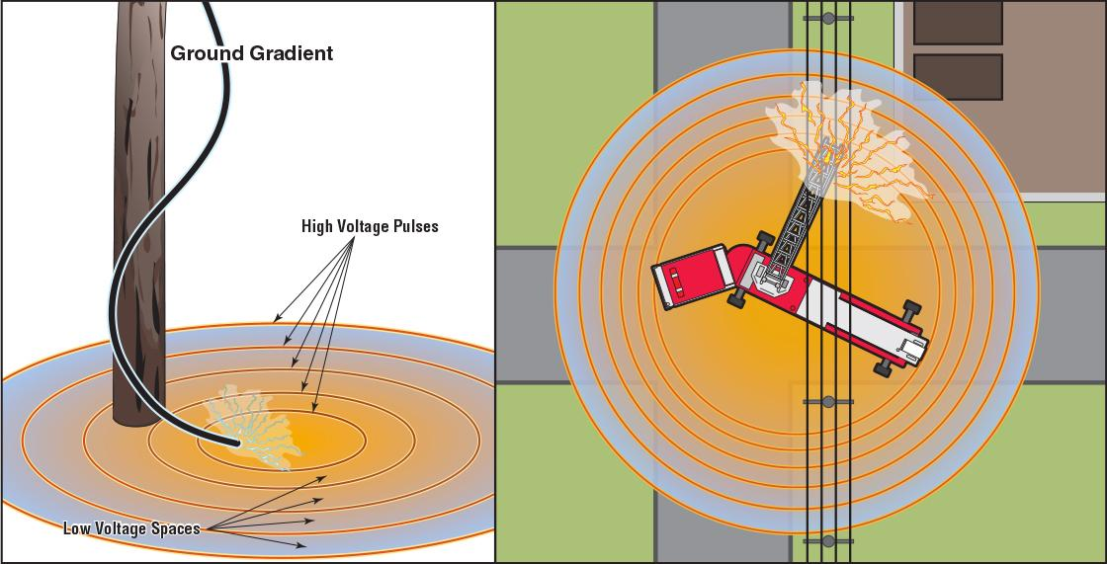
Ground Gradient
(Cont.)

Slide 104
Ground Gradient
If you find yourself in a gradient field or feel a tingling in your legs
Place feet close together
Hop or shuffle until out of the danger area
Do not attempt to walk or crawl

Slide 105
CAUTION
To exit a ground gradient area, keep both feet in contact with each other and hop or shuffle out of the affected area.

Slide 106
Small Electrical Fires
Use extinguishers rated for Class C fires
  Clean agents
  Multipurpose dry chemical agents
Water is inappropriate to use on energized equipment
  Shock hazard or damage to equipment
  If water must be used, apply from a distance in fog or broken stream

Slide 107
Transmission Lines And Equipment
Broken electrical lines can start fires
  To reduce risk of shock, cordon off around where the line contacts the earth
  If ground cover fire starts, wait for the fire to burn away from the point of contact before attempting to extinguish it
  If no risk to life and property, notify the utility company, control the scene, and deny entry
  Only utility personnel should cut power lines
(Cont.)

Slide 108
WARNING
Assume that all power lines are energized until the power company informs you otherwise.

Slide 109
Transmission Lines And Equipment
Transformer fires
  Use dry chemical or carbon dioxide extinguisher for ground-level fires
  Allow pole-top transformer fires to burn until utility personnel can put out the fire
  If fire is burning through a wooden cross-arm that would cause the power line to fall, some departments extinguish it with a fog stream
  Always follow SOPs

Slide 110
REVIEW QUESTION
What must take place before fire suppression can occur at an incident involving energized electrical equipment?

Slide 111
REVIEW QUESTION
What can you do to help protect yourself and your team at an incident involving energized electrical equipment?

Slide 112
Hazard Awareness In Underground Spaces
Transformer vaults
Mechanical spaces
Tunnels
Caves
Sewers
Storage tanks
Trenches
Subways
(Cont.)

Slide 113
Hazard Awareness In Underground Spaces
Safety
  Recognize inherent hazards
  Only specially trained technical rescue units should enter to conduct fire suppression
  Fire Fighter II’s role is to keep fire contained until more qualified personnel arrive
(Cont.)

Slide 114
Hazard Awareness In Underground Spaces
Atmospheric and physical hazards
  Oxygen deficiencies
  Flammable gases and vapors
  Toxic gases
  Extreme temperatures
  Explosive dusts
  Limited entry and egress
  Cave-ins or unstable support members
  Standing water or other liquids
  Utility hazards — Electricity, gas, sewage
(Cont.)

Slide 115
Hazard Awareness In Underground Spaces
Plant or building supervisors or other knowledgeable people at the scene may provide valuable information about the fire and hazards
Preincident plans reduce guesswork
(Cont.)

Slide 116
Hazard Awareness In Underground Spaces
Prearranged hazard mitigation plans should include provisions for
  Victim and rescuer protection
  Control of utilities and other hazards
  Communications
  Fire extinguishment methods
  Ventilation
  Lighting

Slide 117
REVIEW QUESTION
What hazards exist at incidents involving underground spaces?

Slide 118
Learning Objective 4
Explain the use of postincident reports.

Slide 119
Postincident Reports
Written to describe incident details
Vital to fire department operations
Available to the public — Must be complete and written in terminology the public can understand
Legal documents — Possible legal consequences if reports are inaccurate or incomplete
Fire Fighter II may be assigned to create a postincident report
(Cont.)

Slide 120
Postincident Reports
Information in postincident reports is used for
  Assessing departmental needs
  Budgeting
  Determining trends in types of responses
  Determining trends in firefighter injuries
  Providing information for national fire safety data bases
  Determining trends in fire cause
  Determining requirements for fire and life safety education programs
  Providing information to insurance rating agencies
(Cont.)

Slide 121
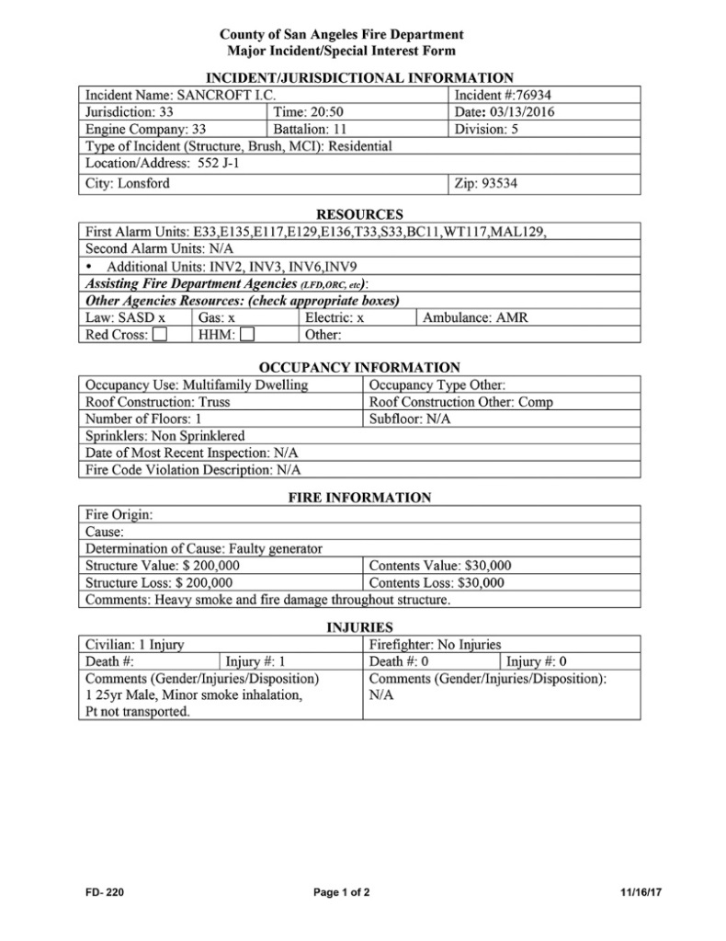
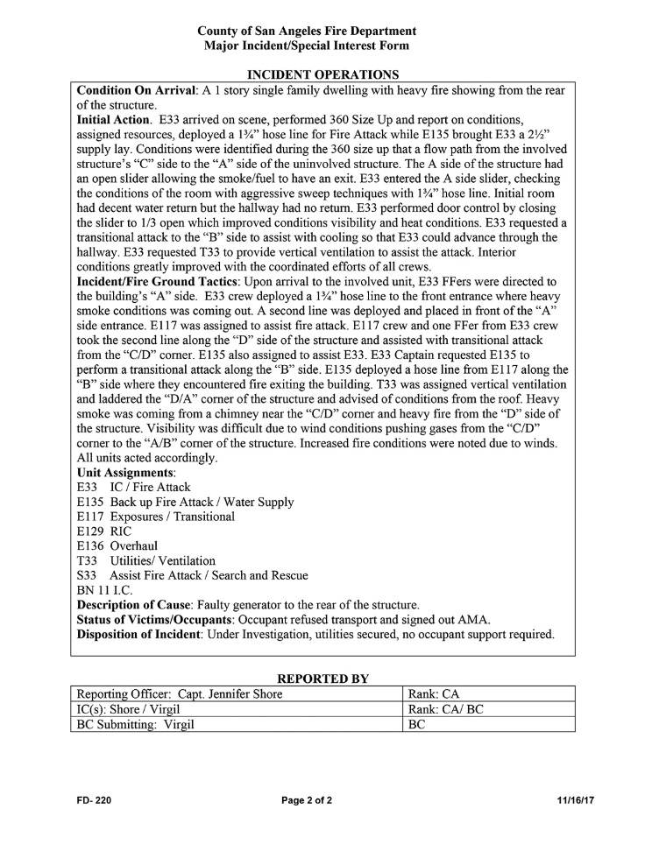
Postincident Reports
Generally based on a form or checklist
(Cont.)

Slide 122
Postincident Reports
NFPA 901 — Standard Classifications for Incident Reporting and Fire Protection Data
NFIRS —
National Fire Incident Reporting System
(Cont.)

Slide 123
Postincident Reports
General information that may be required on incident reports
  Fire department name, incident number, district name/number, shift number, and number of alarms
  Names and addresses of occupant(s) and/or owner(s)
  Type of structure, primary use, construction type, and number of stories
  How the emergency was reported (9-1-1, walk-in, radio)
  Type of call (fire, rescue, medical)
  Action taken (investigation, extinguishment, rescue)
(Cont.)

Slide 124
Postincident Reports
General information that may be required on incident reports
  Property use information (single-family dwelling, commercial property
  Number of injuries and/or fatalities
  Number of personnel and type of apparatus that responded
  How and where the fire started
  Method used to extinguish the fire
  Estimated cost of damage
  Remarks/comments (usually a narrative of the incident written by the officer in charge)

Slide 125
REVIEW QUESTIONS
Why are postincident reports created?
Why must information contained in postincident reports be complete and accurate?

Slide 126
QUESTIONS
Are there any questions about this content?

